Slide 1

MUFG Branch BTMU Projects Overview
03 Apr 2019

Slide 2
Agenda
AML Cleanslate project
EPP – Upgrade Project
FINCEN & TRADE SURVEILLANCE PROJECT
Areas of Improvement
Current Expected Credit Loss(CECL)
RDC to Hotscan Project
Support Projects
AML Data track/ Platform track
AML Cleanslate CDO Track

Slide 3
AML CLEANSLATE

Slide 4
AML Cleanslate Project
Objective
As the current system of Actimize going to expire, the key goal of the project is to provide data required for the SAS AML platform and to enhance and improve the Branch’s (BTMU-NY) BSA/AML Compliance Program. AML Cleanslate was started in Dec 2017, the project was divided into 2 sub projects (Data track and Platform track).
Project Scope
ETL Solution
N-Tier
The data needed by the new SAS platform will be consolidated by EDW instead of AML hub. N-Tier tool will be used for data reconciliation within EDW.
Creating the new dashboard will include:
Reconciling AML platform data between new hops /systems not currently covered by the dashboard
Introducing new data checks across the new systems like Trend check, Filter trend
To support n-Tier and QlikView enhancements.
Creating the connectivity between the dashboards (QlikView and n-Tier) to be more users friendly.
We have created the Mapping specs and Unit test scripts.
We started working on the ETL activities which from EDW core to EDW out and EDW Out to Out files for all the categories like Account, Account Balance ,Party, Address, Cashflow, GPP, EPP and BESS
We have captured the artifacts and created the test cases.
We have created the Review documents for all the mappings.
We had a multiple review sessions with Manas and Jeff, we have implemented the suggestions given by Jeff.
We have created the n-tier objects for all the categories. Development has completed and we have migrated the code to SIT and SIT testing completed.
We have started testing the objects for all the categories, which we had multiple review sessions with Ben.
The suggestions which were provided by Ben and team we are implementing for all the categories.
We completed SIT successfully
Currently UAT is in-progress.
We have started capturing the results and preparing artifacts for the test cases.
Technologies
Informatica Power center, IDQ, N-tier, DB2, Tidal, Autosys

Slide 5
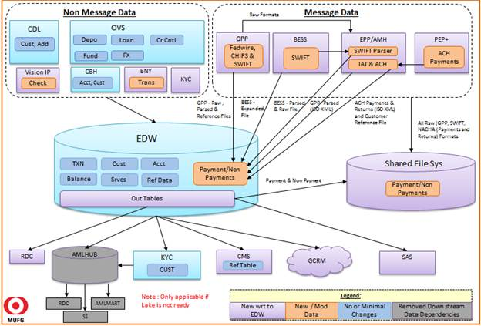
AML Project Architecture

Slide 6
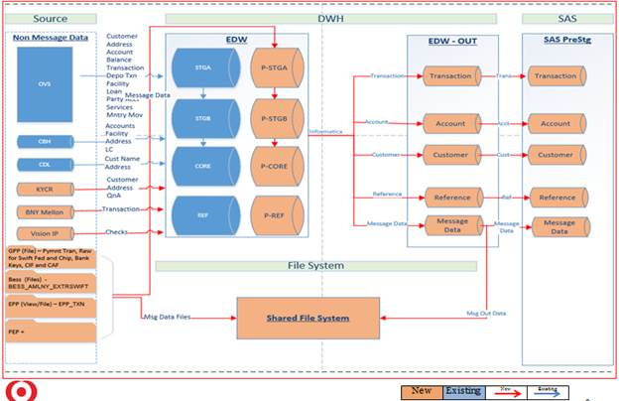
AML Data Flow Diagram

Slide 7
Different Source Systems & Transactions
Product Types | Entity Type | Source System
Deposits, Loan Deals | Account | OVS (Overseas)
Deposits ,Loans | Transaction | OVS (Overseas)
Checks (lock box , RDC) | Transaction | BNY Mellon (Bank of NewYork Mellon), Vision IP
Payments(Completed , Cancelled) | Wire | GPP (Global Payment Process)
Payments | Wire | BESS (Banking Electronic Support System)
Customer | Customers data | CDL (Central Directory Layer)
Customer | Customers Data | KYC (Know your customer)
Deposits ,Loans | Account Balance | OVS
Trade Finance | Trade Finance | T360(Trade 360)

Slide 8
Cleanslate CDO Track

Slide 9
Cleanslate CDO Track Project
Project Objective
Clean Slate Data project is part of the Clean Slate Initiative and is separate but interrelated to the Clean Slate Platform project.
The overall objective of the Clean Slate program is to enhance and improve the Branch’s (BTMU-NY) BSA/AML Compliance Program through effective and robust monitoring tools and workflow management system.
Project Scope
DQ check for various KDE’s coming from OVS, GPP, BESS, EPP/PEP+/AMH, BNY Mellon, KYC, CDL and Vision IP. To facilitate the need to view the lineage of wire payment data from source to platform.
DQ Dimensions:
Completeness – Data must include all necessary values
Conformity - Data values must agree with the required format (including valid values)
Continuity - Data values must not change meaning across various points in the supply chain
Technologies
Informatica PC(ETL), IDQ (Data Quality), DB2 (Database), Greenplum (Database), UNIX & Autosys(Scheduler)

Slide 10
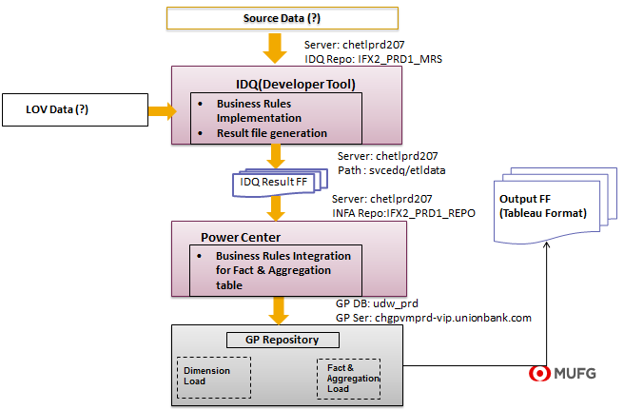
CDO Track Architecture

Slide 11
Current Expected Credit Loss Project(CECL)

Slide 12
Current Expected Credit Loss
Project Objective
MUAH must achieve compliance to ASU 2016-13. The standard provides guidance on measuring credit impairment, generally evaluating financial instruments. This guidance will necessitate changes to data infrastructure, technology infrastructure, models/methodology, ACL process and accounting.
Project Scope
DECM Team is responsible to extract RETAIL data from different sources (Experian, Hyperion, Lending Club, Mortgage programs, First Data Corp etc.)
MUFG CORE Team is responsible to store all the data provided by DECM and load into the new data model built for Retail.
MUFG CORE will check for linkages and create a report, if any breaks are observed
The input from DECM to MUFG CORE will be Delimited Flat Files and output of MUFG CORE will be a cleaner version of Delimited Flat Files based on the Standard Output Format (SOF) finalized by business
The resultant output files from MUFG CORE will be consumed by ACL CORE Team for CECL calculations using Quantitative Risk Management (QRM) Model
The project will be carried out in phases
Technologies
Informatica (ETL), DB2 (Database), UNIX, TIDAL (Scheduler)

Slide 13
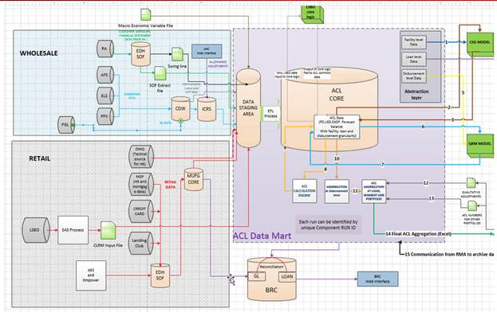
MUFG CORE – ACL Data Flow

Slide 14
RDC to Hotscan Project

Slide 15
RDC to Hotscan Project
Objective
Due to the issues with the current RDC OFAC Screening and challenges for BTMU Customer Data Name Screening, Project 18A3342 needs to move the BTMU Customer screening data to HOF by 12/31/2018. The sourcing BTMY NY screening data into HOF has been split into two phases as agreed by Technology and Business.
Phase I involved sending the BTMU data to HOF that is currently being sent to the RDC (Regulatory Data Corp.) for Name and Address Screening from AMLHub instance. Phase 1 deliverables have been met in December 2018 by HOF source data from AML Hub instance of EDW/DWH.
The scope for Phase II deliverables for the data will be sourced from EDW/DWH (GSI Q73)
Scope
For the Phase II effort, the data feed from Phase I - AMLHub will be replaced with EDW instance of the Data Warehouse since AML Hub will be decommissioned as part of the Clean Slate project. Additionally, name and addresses screening data from KYCR will sourced as daily screening and reactivation files as a part of the Clean Slate project go live. This essentially means that Hotscan expansion Phase is fully depending on Clean Slate going live. Hotscan phase II can only go live after Clean Slate go live.
Additionally, based on the HOF requirement, BTMU’s signatory data from SQN (Signature Verification System) will be sent directly to HOF. Systems involved for the Phase II will be SQN , DWH-EDW instance and HOF. The file(s) transmission will the via MFT-GIS infrastructure.
DWH – AMLHub instance will generate the data files in the xml format that will retain the special characters. There will be two files sent to HOF – RIB (Review Inquiry Batch) and RIP (Review Inactive Portfolio) and transmitted to HOF via MFT (Managed File Transfer) –GIS (GIS – Global Infrastructure Security) infrastructure.
Data Deduplication : DWH is going to follow the same data deduplication logic that is currently being used in RDC data feeds. All screening records in DWH from source systems CDL, KYCR, T360 and OVS are compared against CDL records (Source ID = ‘CDL’) CDL-Legal-Name-Address Key to qualify for deduplication. The records where the Name-Address key of the record from any source system match with CDL Legal-Name-Address Key are not sent to Hotscan for screening. Key contract for the Name and Address Key for all the records: Full Name + Address Line 1 + Address Line 2 + Address Line 3 + Address Line 4 + Address City+ Address State+ Address Zip code + (Address Country Name is not available then use Address Country Code else use Address Country Name)
Technology
Informatica, TIDAL Scheduler, UNIX, Database like DB2,SQL

Slide 16
RDC to Hotscan Project Phase 2 - Architecture

Slide 17
Support Projects

Slide 18
Support Projects
Objective
Provided support which includes Enhancements, Execution, Issue handling, Monitoring in all phases (SIT, UAT and Prod)
Provide SIT, UAT support for the Genesis, EPP, T360 ,AML, AML Platform, AML Data Track and N-tier
Scope
Perform, organize and streamline operational tasks.
Monitor for problems, analyze root causes and provide resolution and escalating when required for all Prod and Non-Prod jobs
Maintain documentation for all operational malfunction and associated code changes.
Interact with clients and provide status update.
Closely monitoring DWH batch jobs in production environment and Handling the production job failures.
Discussing with on call person about the batch issues and working on the solution.
Sending Daily Batch Status Reports.
Executing DWH batch jobs in SIT and UAT Environment, We are also engaged in route cause analysis for any failures that occur during the execution phase. Failures will be communicated to the concern team via appropriate channels.
N-tier job execution in SIT, UAT
Checking, analyzing and closing the IM tickets and assigned to the corresponding group if required.
Preparing Play batch document for all the production jobs.

Slide 19
Support Projects
Supportive Systems
Supporting the below source systems
OVS,P/S, Genesis, WSS, ZEUS ,GCARS, GPP, T-360, CDL , SOPHIS , ABCP , ORACLE G/L , ANTONORI , IRIS , IMARKS , MOODYS, MARKIT Transfile
Supporting the below target systems
OVS , MARIO , ODH , RMDB , ZEUS , VISION IP , OFSA FILES , PNL REPORTING, COLLATERAL MANAGEMENT SYSTEM , CMS/ CAA , FED PLEDGE , FAT , GMDA,
IRIS, Reg Reporting , Risk Manager , Record Keeping
Architectural Diagram
Please refer the below link :-
https://teams.ad.btmna.com/sites_c/InformationManagement/DWAG/SiteAssets/Wiki/Data%20Flow%20Diagram/DWH%20HLD%20Data%20Flow%20Post%20OVS.vsd
Technology
Informatica, TIDAL Scheduler, HPSM, UNIX, Database like DB2,SQL

Slide 20
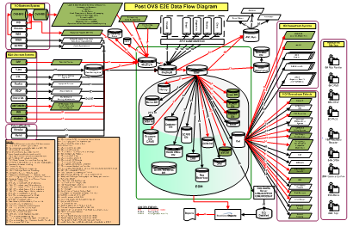
Architectural Diagram

Slide 21
EPP Upgrade Project

Slide 22
EPP -Upgrade Project
Business Objective
The objective of this project is to migrate all of the EPP(Enterprise Payment Platform) Payment Broker interfaces from the existing Payment Broker to a new environment FTM(Financial Transaction Manager). There will be no change in the functionality of these interfaces in this project. Migrating to FTM v3 will afford the opportunity to create a more componentized implementation, allowing for flexibility in the future addition of more services, and making the future modification of existing services less impactful on the Payment Broker as a whole
Context
Solution
Methodology
Key Objectives:
For the AML Hub, this EPP upgrade project necessitate changing the way the source data is accessed from the current transaction view to a new file based method
Development of ETL for new AMH file to AML Staging area and enhancing the AML CORE load
Setup new Tidal jobs for AMH source data load
Changes to N-tier reconciliation to access the new source file from AMH and AML Hub stage table
Receive ACH transaction data from AMH in a XML file (as opposed to current transaction view).
Data model changes to Stage table.
Develop/modify ETL process to load source data from AMH to AML Hub staging table.
N-tier to modify to use new AMH interface file and AML Hub Stage table for reconciliation purpose.
Technologies
Informatica, n-Tier Reconciliation tool

Slide 23
EPP -Upgrade Project - Architecture

Slide 24
FINCEN & TRADE SURVEILLANCE PROJECT

Slide 25
FINCEN & TRADE SURVEILLANCE PROJECT
FinCEN Objective
KYCR application will enhance existing KYC/R(Know your Customer/Required) Application to address new business requirements that have been defined to meet the FinCEN(Financial Crimes Enforcement Network) Regulatory requirements. This will include updates to existing form templates, specifically CDD, EDD Section and Attachment section to include the beneficial owner and controlling party information.
Project Scope
The changes will update database schema and application layout to accommodate new data fields according to the flows defined in below section, for which we involved in ETL development.
CDL(Central Directory Layer) to KYC/R (Know your Customer/Required)
CDL to DWH
DWH to KYC/R
CDL to RDC(Regulatory Data Corp.)
KYC/R to RDC
KYC/R to CDL
Trade Surveillance
Based on recommendation from internal and external parties, Market surveillance and Conduct team implemented more effective Swap Dealing and related Market Conduct Surveillance programs, the scope of which includes FOREX Cash, Options and Swap. our scope is to make the data available for the reports in DWH from the respective source system using Informatica which involves modification of 5 workflows.

Slide 26
Areas of Improvement

Slide 27
Areas of Improvement
Automation
We can Improve the performance and reduce the manual efforts by automating exiting File mover Scripts
All the new requirements and any issue fixes should be parallely communicated by the Informatica team.
The Tidal scheduling tool sometimes goes down and is very slow, comparatively we can use CA Workstation or AutoSYS for scheduling purposes.
DQ Area
Data Quality Machine learning process
Data Analysis Automation

Slide 28
Capgemini Team Structure
Dheeraj Khanna
Ajay Jha
Vaibhav Pande
RadhaKrishna Keremoole
Ravi Gabra
Platform Track Team
Data Track Team
CECL
EPP
Support Team
CDO
RadhaKrishna Keremoole
Srinidhi Vadigepalli
Bijeet Roy
Sanjay Sethi
Maksim
Venkata Molakalapalli
Swetha Rajanna
Gajendra R
Suresh Viswanath
Praveen Prudhvi
Kumar Palaniappan
Rajiv Jain
Santhosh Jella
Anuj Bansal
Jibran Shaik
ChandanaPriya
Manivasagan N
Shivam Kumar
Mani Kishore
Vinod Kumar
Pavan Mysore Ramesh
Sailaja P.V.
Mansur Khan
Srinivasa Rao Dasari
Venkata Narasa Reddy
Srikanth Thombre
Parikshith
Pradeep Dekka
Surya Vasi reddy
Kanav Gupta
Jyotiranjan
Ranjit Narayanappa
Raushan Kumar
Geetha Pandolla
Sreenu Mupparaju
Madhunika R
RDC to HOTSCAN
Bidap Chandrakiran
Nagaveni B
Madhura Mayya
Harish Kumar
Vijaya Lakshmi
28

